Slide 1
Project Phase – 2 Final Review Retrieval Augmented Generation based Knowledge Extraction for Material Science Domain
6
C
Carbon
29
Ca
Project Supervisor: Dr. Kritesh Kumar Gupta
Calcium

Slide 2
TEAM MEMBERS
22
Ti
Titanium
Ashwin Devan | CB.EN.U4AIE21104
K Prashanth | CB.EN.U4AIE21126
M Srinivasa Sai Kumar Reddy | CB.EN.U4AIE21128
M Sai Rahul | CB.EN.U4AIE21130

Slide 3
Table of contents
Introduction
Problem Statement
Proposed Work
Literature Review
Dataset
Methodology
Results
Deployment
Conclusion & Future Scope

Slide 4
01 Introduction
22
Ti
Titanium
14
Si
Silicon

Slide 5
The rapid advancement of Materials Science has significantly contributed to the discovery and development of Refractory High-Entropy Alloys (RHEAs), which are known for their exceptional strength, thermal stability, and oxidation resistance.
These properties make them highly suitable for Aerospace, Nuclear Reactors, and High-Temperature Structural Applications.
However, the complexity of RHEA design demands a deep understanding of material composition, microstructural evolution, mechanical properties, and processing techniques. Traditional literature review methods for extracting scientific insights are time-consuming, labor-intensive, and prone to human bias.
The rapid growth of research publications further complicates the process, making it difficult to synthesize and extract meaningful information efficiently. To address these challenges, Artificial Intelligence (AI) and Natural Language Processing (NLP) have emerged as powerful tools for automating knowledge discovery in materials science.

Slide 6
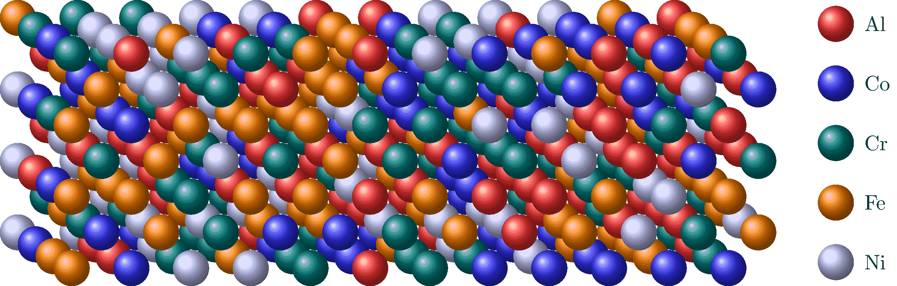
"High entropy" means these alloys have five or more elements mixed together in similar amounts, creating a complicated internal structure and a lot of randomness. This randomness comes from having many different types of atoms in the alloys, leading to varied and complex structures that can be adjusted for specific useful qualities.
High entropy alloys usually have elements that form different crystal patterns and show unique traits, such as high strength, hardness, resistance to wear, good thermal stability, and resistance to corrosion, compared to regular alloys.
Source: https://tikz.net/hea/

Slide 7
Our previous work:
M. Sai Rahul, Ashwin Devan, Kurakula Prashanth, M. Srinivasa Sai Kumar Reddy, and Kritesh Kumar Gupta, Design of High Entropy Alloys by using Machine Learning driven Bayesian Optimization, 5th International Conference on Current Trends in Materials Science and Engineering, (Presented).
Machine Learning-Driven Bayesian Optimization for HEA Design
Developed an ML-based Bayesian Optimization framework.
Efficiently surveyed the vast compositional space of Refractory High-Entropy Alloys (RHEAs).
Captured structured data (composition, test temperature, yield strength to density ratio).
Forecasted optimal alloy compositions with minimal experimental inputs, reducing costly trial-and-error methods.
Limitation: Unable to incorporate unstructured data and additional context for detailed information.

Slide 8
02 Problem Statement
18
Ar
Argon
79
Au
Gold

Slide 9
Researching Refractory High-Entropy Alloys (RHEAs) is a complex and time-consuming process, requiring scientists to balance temperature resistance, strength, and weight while exploring new compositions. However, finding relevant information involves manually looking through vast amounts of research papers, slowing down innovation and making discovery inefficient. Traditional trial-and-error experimentation is costly and impractical for rapid material development, while existing general AI models struggle to provide accurate, domain-specific insights, often leading to misleading or incomplete information.
Without an AI tool specifically designed for materials science, researchers lack an efficient way to retrieve precise technical answers and predict alloy properties. To address this, we need a fine-tuned AI model trained on RHEA-specific literature, capable of automating knowledge extraction, improving material screening, and accelerating alloy discovery, ultimately making research faster, more reliable, and cost-effective.

Slide 10
03 Proposed work
79
Au
Gold

Slide 11
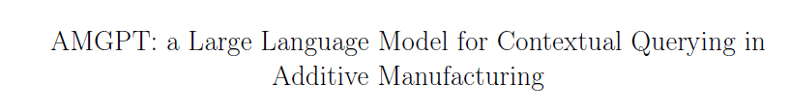
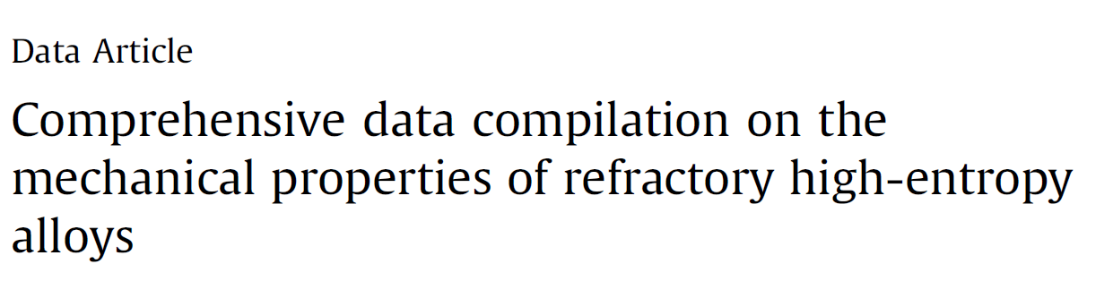
The base paper, "AMGPT: A Large Language Model for Contextual Querying in Additive Manufacturing" presents a domain-specific Large Language Model
Source: https://doi.org/10.1016/j.addlet.2024.100232
(LLM) that utilizes Retrieval-Augmented Generation (RAG) to enhance knowledge extraction. This paper introduces domain-specific embeddings with advanced language modeling techniques, ensuring precise and context-aware responses tailored to additive manufacturing. By leveraging a curated dataset, AMGPT effectively addresses the limitations of general-purpose language models in specialized scientific fields, providing an efficient AI-powered research assistant for material scientists.
Inspired by this approach, we have applied a similar AI-driven knowledge extraction system to the field of Refractory High-Entropy Alloys (RHEAs). Our implementation is based on the dataset from "Comprehensive Data Compilation on the Mechanical Properties of RHEAs" which contains information on 321 alloys and the reference
Source: https://doi.org/10.1016/j.dib.2018.10.071
papers present in it, covering a wide range of compositions and mechanical properties. By fine-tuning our model on this dataset, we enable efficient literature review and context-aware querying, significantly reducing manual efforts. This adaptation streamlines material screening, accelerates alloy design, and enhances knowledge discovery, fostering innovation in high-temperature material research.

Slide 12
04 Literature Review
29
Ca
Calcium
3
LI
Lithium
79
Au
Gold

Slide 13
Research | Dataset | Methodology | Key Findings | Limitations
AMGPT: A Large Language Model for Contextual Querying in Additive Manufacturing | Vector database documents; Embedding model using "sentence-transformers/all-mpnet-base-v2"; Used Hugging Face Datasets library | LLaMA2-7B & Sentence-Transformers; Dual-encoder framework with query/document encoders; Stored embeddings in vector database | Improved RAG performance; Reduced hallucination; Enhanced real-time NLP task performance; Semantic embeddings ensure contextually accurate and relevant query responses | Limited domain jargon; No experimental data
MatSciBERT: A materials domain language model for text mining and information extraction | 150,000 materials science papers (~285 million words); Domains: inorganic glasses, metallic glasses, alloys, cement; SOFC-Slot, Matscholar datasets | Fine-tuned SciBERT with transfer learning; Dynamic masking and large batch sizes; Supervised learning for downstream tasks | Improved NER accuracy by 6.3 on SOFC dataset and 3.2 on Matscholar; 96.22% accuracy in glass-related abstract classification; Excels in domain-specific tasks versus SciBERT/BERT baselines | Limited to abstracts
Polymer Property Extraction | 2.4M materials science abstracts (~130,000 polymer-specific); 750 manually annotated abstracts with 8-entity ontology; Multiple materials science datasets including PolymerAbstracts | Fine-tuned PubMedBERT for property extraction; Created MaterialsBERT for materials science texts; Automated extraction pipeline with NER, co-referencing, and heuristics | Extracted ~300,000 structured property records from 130,000 abstracts in 60 hours; Identified trends in polymer solar cell efficiency and strength-ductility trade-offs; MaterialsBERT outperforms baseline models | No multi-modal processing; No real-time querying

Slide 14
Gaps Identified
Limited Domain Adaptation: Models are domain-specific with limited domain evaluation.
Scalability Beyond Abstracts: Limited to abstracts; no use of full-text, figures, or tables.
Multi-Modal Data Integration: Only text data used, missing experimental data.
Real-Time Querying: AMGPT shows improvement but lacks domain-specific jargon handling; Materials Pipeline lacks real-time querying.

Slide 15
05 Dataset
29
Ca
Calcium
79
Au
Gold

Slide 16
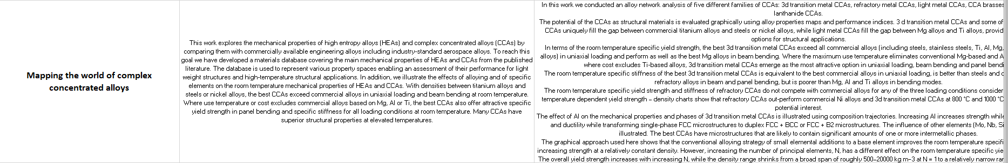
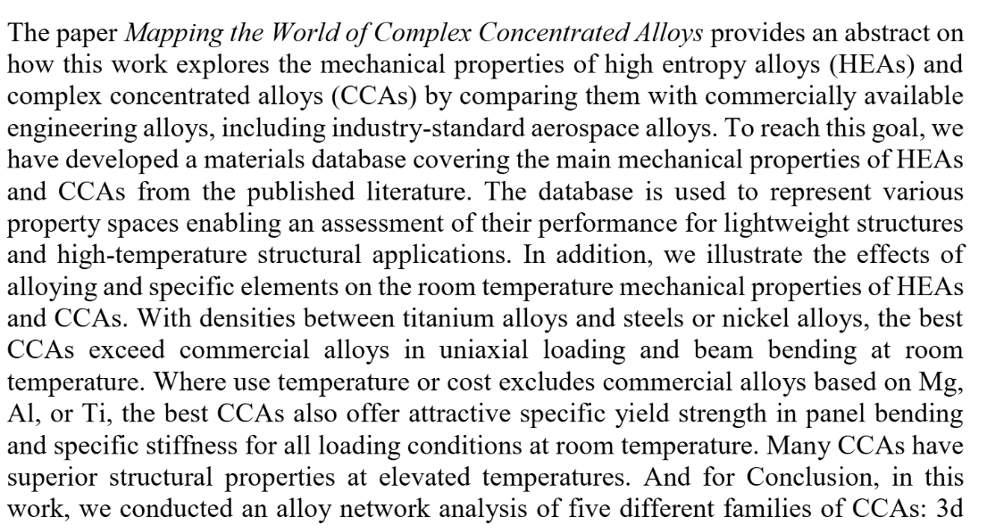

Slide 17
06 Methodology
29
Ca
Calcium
3
LI
Lithium
79
Au
Gold

Slide 18
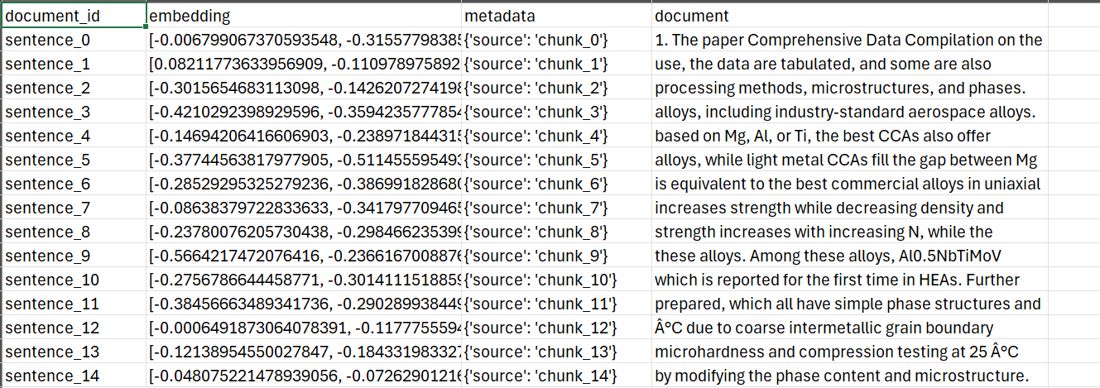
Data Collection
Base Paper
Manual collection of Abstracts and Conclusions
Creating the curated dataset as CSV & PDF
Vectorization using
Embeddings
Storing embeddings in
Chroma Database

Slide 19
Embedding Scheme
Aspect | Bert | MatSciBert
Description | A Transformer-based language model designed to understand word context by considering both left and right contexts simultaneously. | A domain-specific version of BERT trained on materials science literature to improve NLP tasks in materials informatics.
Challenges in Materials Science Domain | Specialized Vocabulary: Struggles with domain-specific terms like chemical formulas and material properties. . Ambiguous Notations: Difficulty with symbols, phase diagrams, and equations. . Contextual Limitations: Terms like "phase transition" vary in meaning across contexts. . . Handling Numerical Data: Issues with experimental results and complex numeric values. | General-purpose NLP models struggle with domain-specific vocabulary (e.g., chemical formulas, phase diagrams, crystal structures). . Materials science literature includes complex terminologies, abbreviations, and numerical data that require specialized processing. . Extracting information for applications like materials discovery and property prediction needs a fine-tuned model.

Slide 20
Key Differentiators | General-Purpose Model: BERT is a versatile language model, not specialized for any specific domain, so it lacks expertise in processing technical and domain-specific language like chemical formulas or material properties. | Domain-Specific Training Data: Trained on thousands of research papers in materials science. Better Tokenization: Effectively understands chemical formulas and material symbols. Improved Contextual Understanding: Better at tasks like relation extraction, text classification, and semantic search.
Architecture | Transformer-based architecture. Bidirectional Attention: Reads text in both directions. Self-Attention Mechanism: Weighs word importance for context. | Same Transformer-based architecture as BERT. Bidirectional Attention: Reads text in both directions. Self-Attention Mechanism: Weighs word importance for understanding material-related sentences.
Primary Use Cases | Text classification, named entity recognition, question answering. | Materials discovery, property prediction, synthesis automation, scientific literature analysis.

Slide 21
Retrieval Augmented Generation (RAG) Framework – Explanation:
The Retrieval-Augmented Generation (RAG) framework is an advanced approach that blends the strengths of information retrieval and natural language generation to enable accurate, context-aware, and up-to-date responses for domain-specific queries.
Unlike traditional QA systems that rely solely on pre-trained models, RAG integrates a retrieval mechanism that fetches relevant documents dynamically at inference time, ensuring that responses are grounded in current and relevant information.
This is particularly important for scientific domains, like RHEA research, where new findings frequently emerge, and terminologies are highly specialized.
Our RAG framework is architected as a modular pipeline composed of four key components — Query Encoder, Retriever, Context Formatter, and Generator. Each component performs a specialized role yet operates in an interconnected manner to deliver end-to-end functionality.
Importantly, this architecture allows the system to answer scientific queries with minimal hallucination, using semantically relevant passages from scientific literature as a basis for generating factually accurate responses.

Slide 22
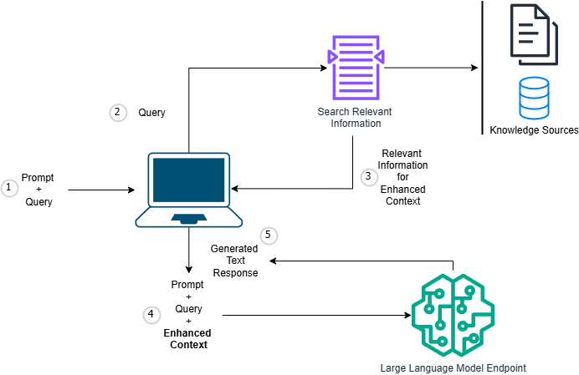
RAG Framework:

Slide 23
Query Encoder:
The Query Encoder serves as the entry point of the pipeline, where raw user questions are transformed into dense semantic vector representations using MatSciBert & Bert embeddings. These embeddings capture not just the surface form of words, but their underlying scientific meaning, which is critical for ensuring relevance in downstream retrieval.
This encoder is tightly integrated with the retriever, ensuring that the embeddings generated are aligned with the structure of the retrieval corpus. Normalization steps such as standardizing chemical notation and vocabulary mapping ensure that queries and documents are encoded in a comparable format. Overall, the encoder plays a foundational role in determining the quality of the search results.
Retriever:
The Retriever is responsible for identifying and selecting the most relevant documents from a precomputed knowledge base using vector similarity search. It compares the query vector generated by the encoder against a corpus of document embeddings, by utilizing cosine similarity as the primary matching metric to retrieve the top 5 documents.
The Retriever interfaces with the Encoder to obtain the query vector and with the Context Formatter to forward the selected documents for further processing and refinement before the generation stage.

Slide 24
Context Formatter:
The Context Formatter acts as a bridge between Retrieval and Generation. It processes the retrieved documents into a structured, context-rich prompt suitable for the language model. Key techniques include sentence-level relevance scoring and organization of documents by similarity. It highlights key segments of text, ensuring that essential scientific data such as formulas and terminology are preserved while trimming less relevant content to fit within model constraints.
The Context Formatter works with the retriever to refine its output by prioritizing content through scoring. It enhances the query with expanded terms and organizes the final prompt to include document boundaries, similarity metadata, and tailored instructions. This structure helps the language model generate concise, accurate responses tied to specific source documents, even without explicit citations.
Generator:
The Generator, powered by Llama 3.1 (8B parameters), synthesizes human-like responses based on the structured prompt from the Context Formatter. It uses custom scientific templates and adjusts its response style based on the query type, ensuring a balance between creativity and factual accuracy with fine-tuned generation parameters like temperature, top-p, and top-k.
After generating responses, the generator's output is validated using automated metrics such as BERT Score and ROUGE to ensure semantic consistency with the retrieved context. While it doesn't explicitly verify citations or numbers, this validation helps minimize hallucination and ensures the final answers are accurate and contextually relevant for scientific users.

Slide 25
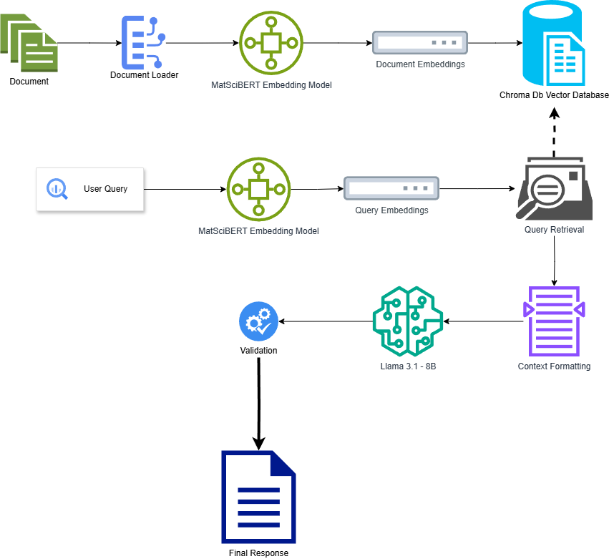
Workflow

Slide 26

Evaluation Metrics
Cosine Similarity: Cosine Similarity measures the closeness of text embeddings by computing the cosine of the angle between them in high-dimensional space. It is crucial for retrieval accuracy, ensuring that only the most relevant text passages are selected before response generation. A similarity score close to 1 indicates high relevance, while a lower score suggests weaker contextual alignment.
BERT Score: BERT Score evaluates the semantic similarity between the generate response and the reference text by leveraging contextual embeddings from models like BERT or MatSciBERT. Unlike traditional metrics that depend on exact word matches, BERT Score compares token embeddings using cosine similarity.
a. Precision: Matching generated words to reference.
b. Recall: Matching reference words to generated.
c. F1 Score: Harmonic mean of Precision and Recall.

Slide 27
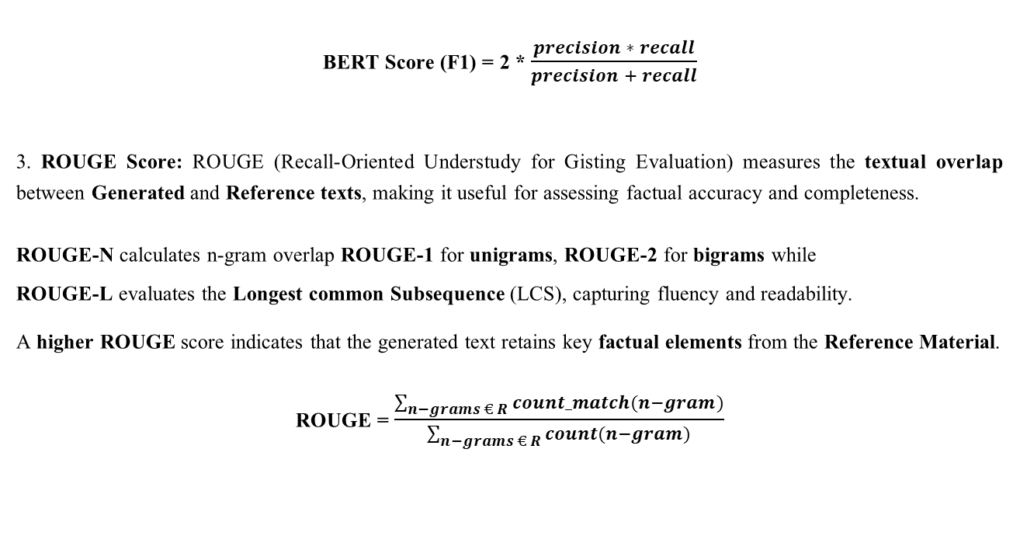
BERT Score (F1) = 2 * $\frac{precision ∗ recall}{precision + recall}$
3. ROUGE Score: ROUGE (Recall-Oriented Understudy for Gisting Evaluation) measures the textual overlap between Generated and Reference texts, making it useful for assessing factual accuracy and completeness.
ROUGE-N calculates n-gram overlap ROUGE-1 for unigrams, ROUGE-2 for bigrams while
ROUGE-L evaluates the Longest common Subsequence (LCS), capturing fluency and readability.
A higher ROUGE score indicates that the generated text retains key factual elements from the Reference Material.
ROUGE = $\frac{\sum_{n−grams € R}{count_match(n−gram)}}{\sum_{n−grams € R}{count(n−gram)}}$

Slide 28
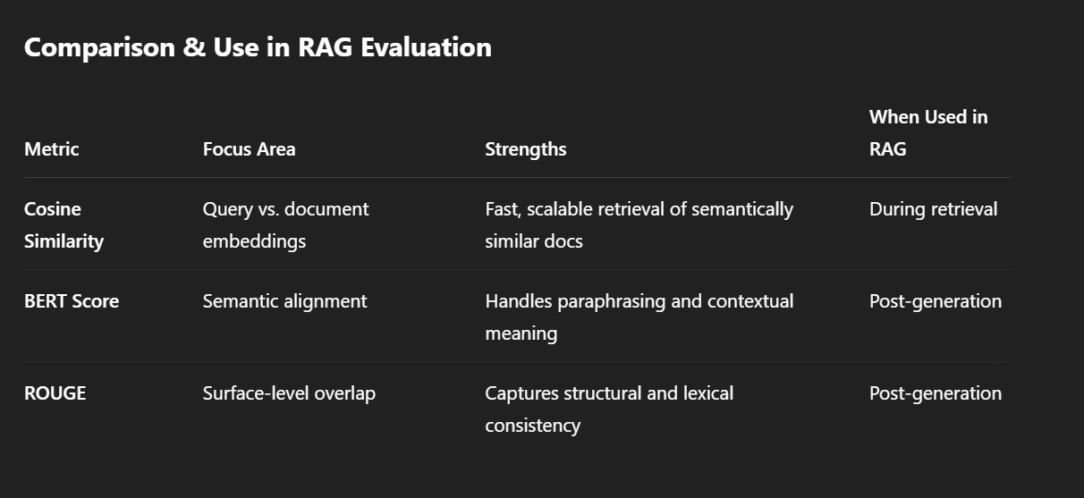

Slide 29
07 Results
79
Au
Gold

Slide 30
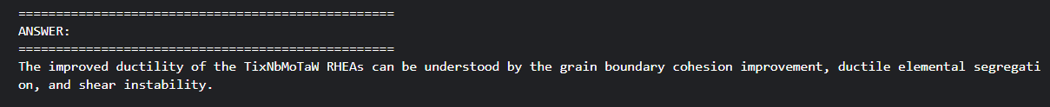
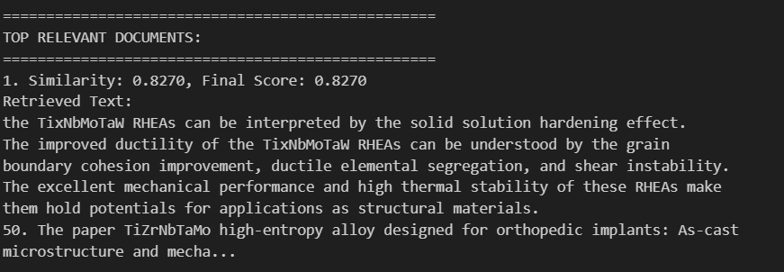
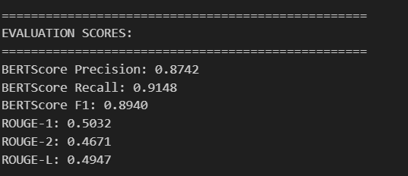
RAG responses using MatSciBert

Slide 31
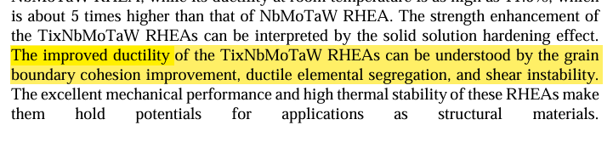
Ground truth: Reference data from Dataset.

Slide 32
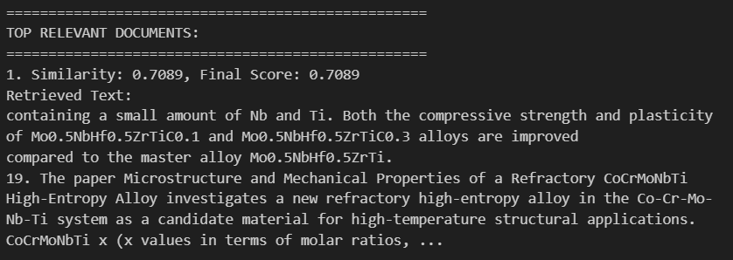
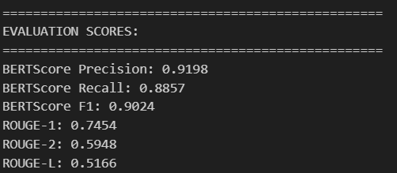
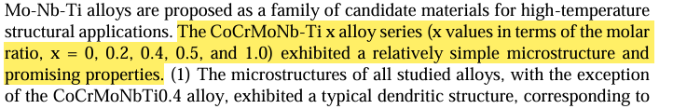
Ground truth: Reference data from Dataset.

Slide 33
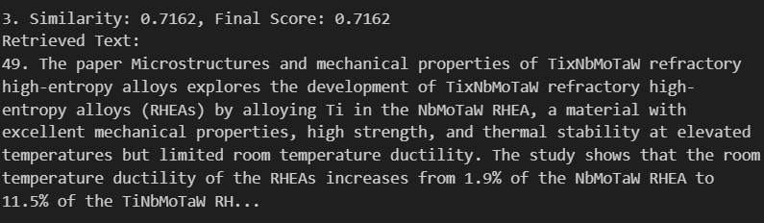
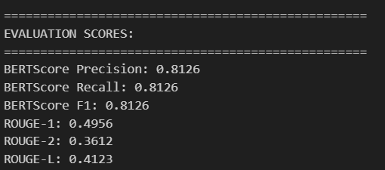
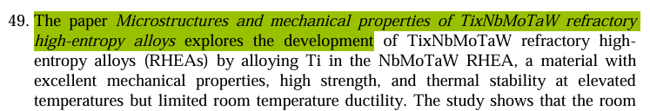
Ground truth: Reference data from Dataset.

Slide 34
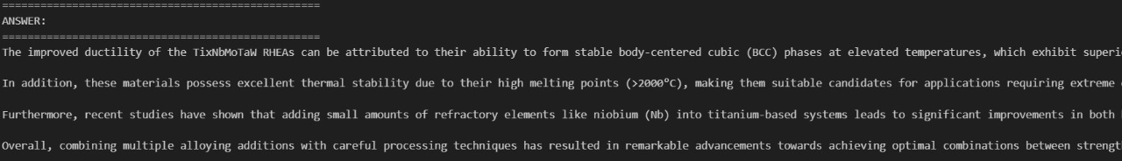
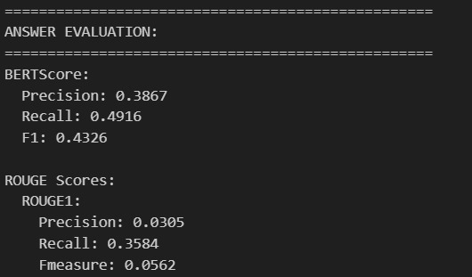
RAG responses using BERT
Generating answer out of context
Ground truth: Reference data from Dataset.

Slide 35
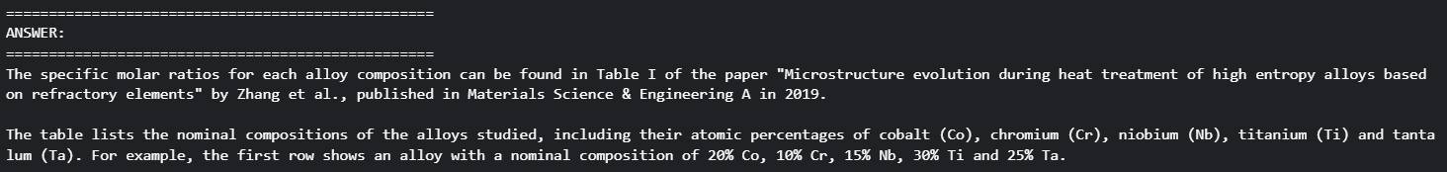
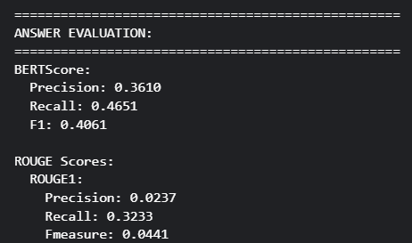
RAG responses using BERT
Generating answer out of context
Ground truth: Reference data from Dataset.

Slide 36
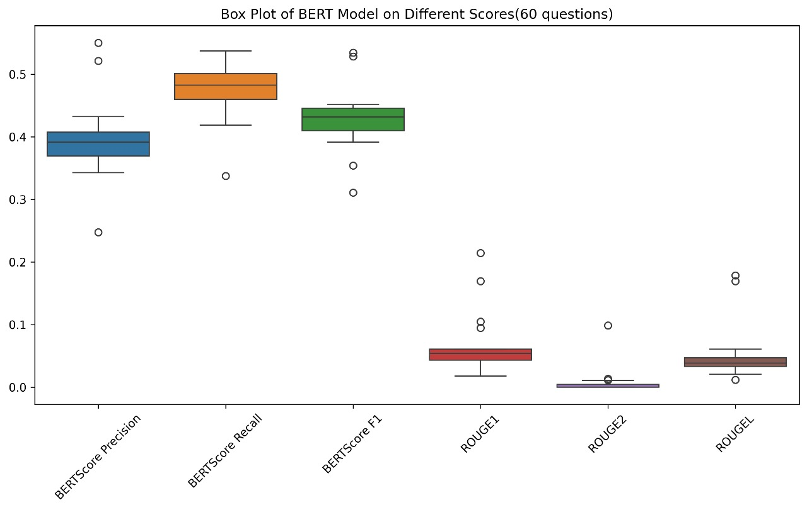

Slide 37
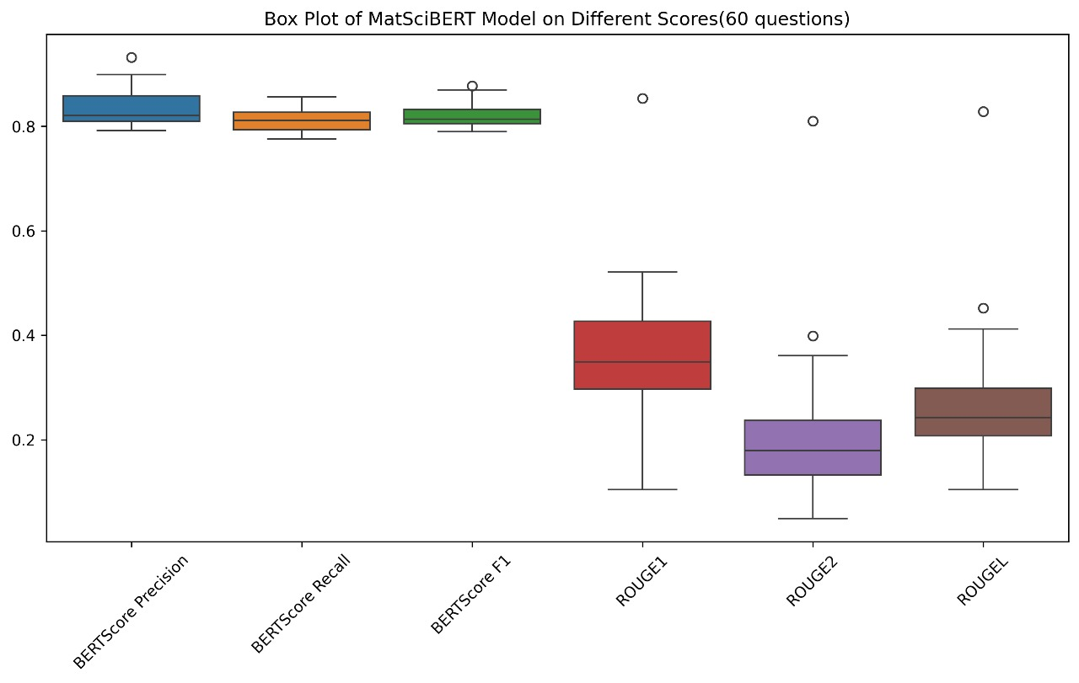

Slide 38
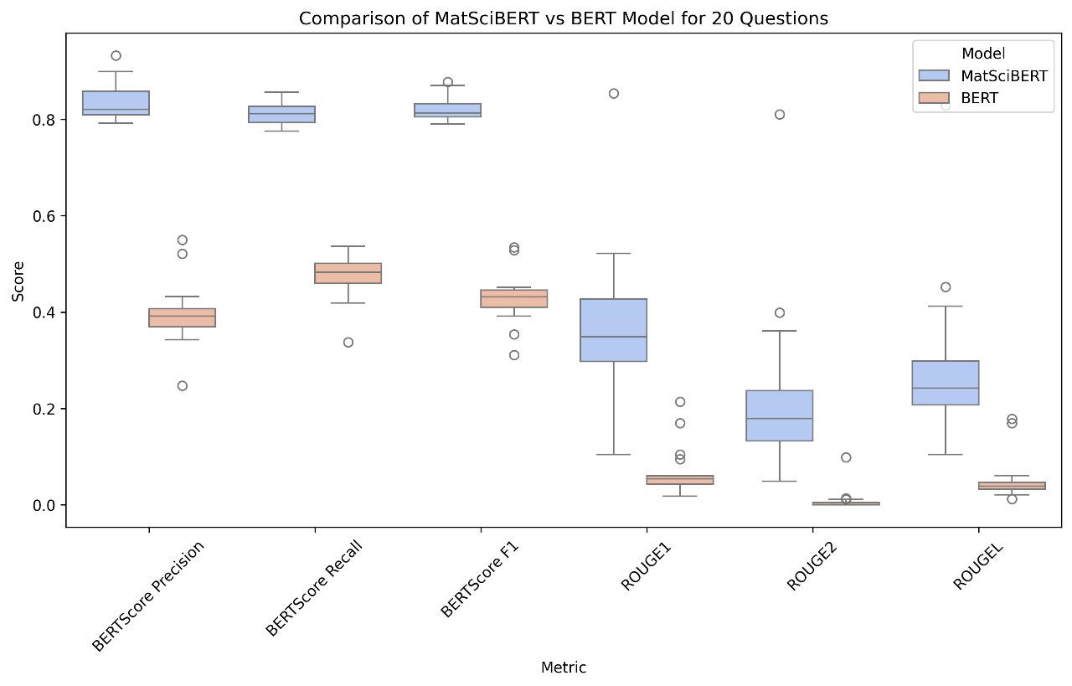
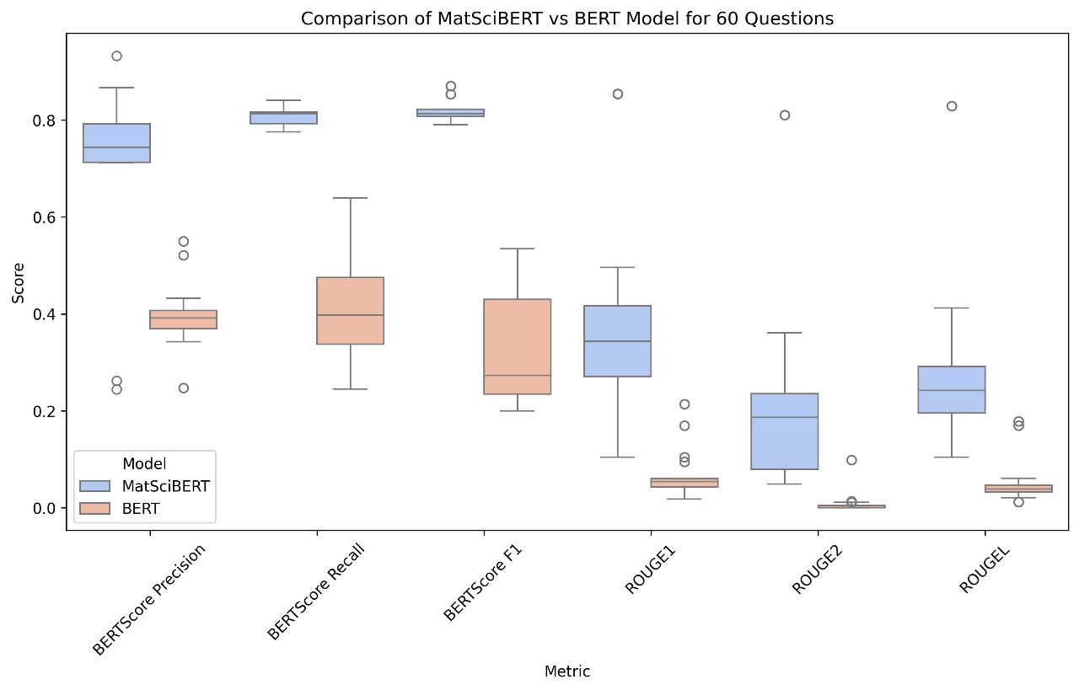
Comparison of MatSciBERT and BERT Model various questions:

Slide 39
08 Deployment
22
Ti
Titanium
14
Si
Silicon

Slide 40

Home Page

Slide 41
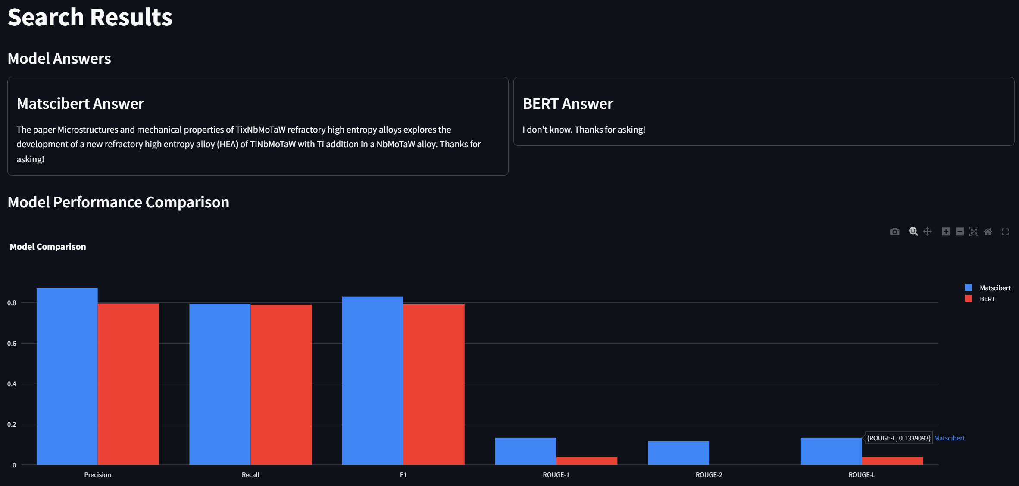
Results Page

Slide 42
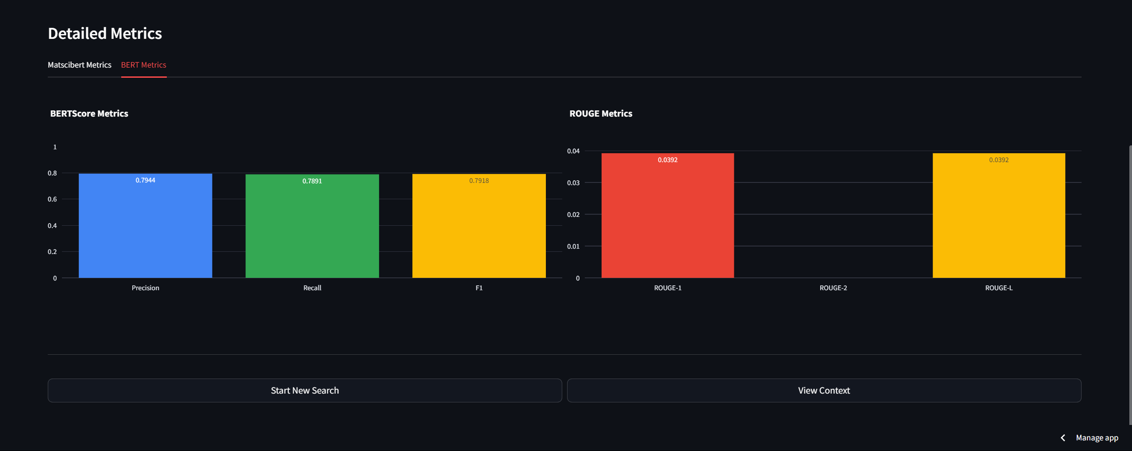
Bert Result

Slide 43
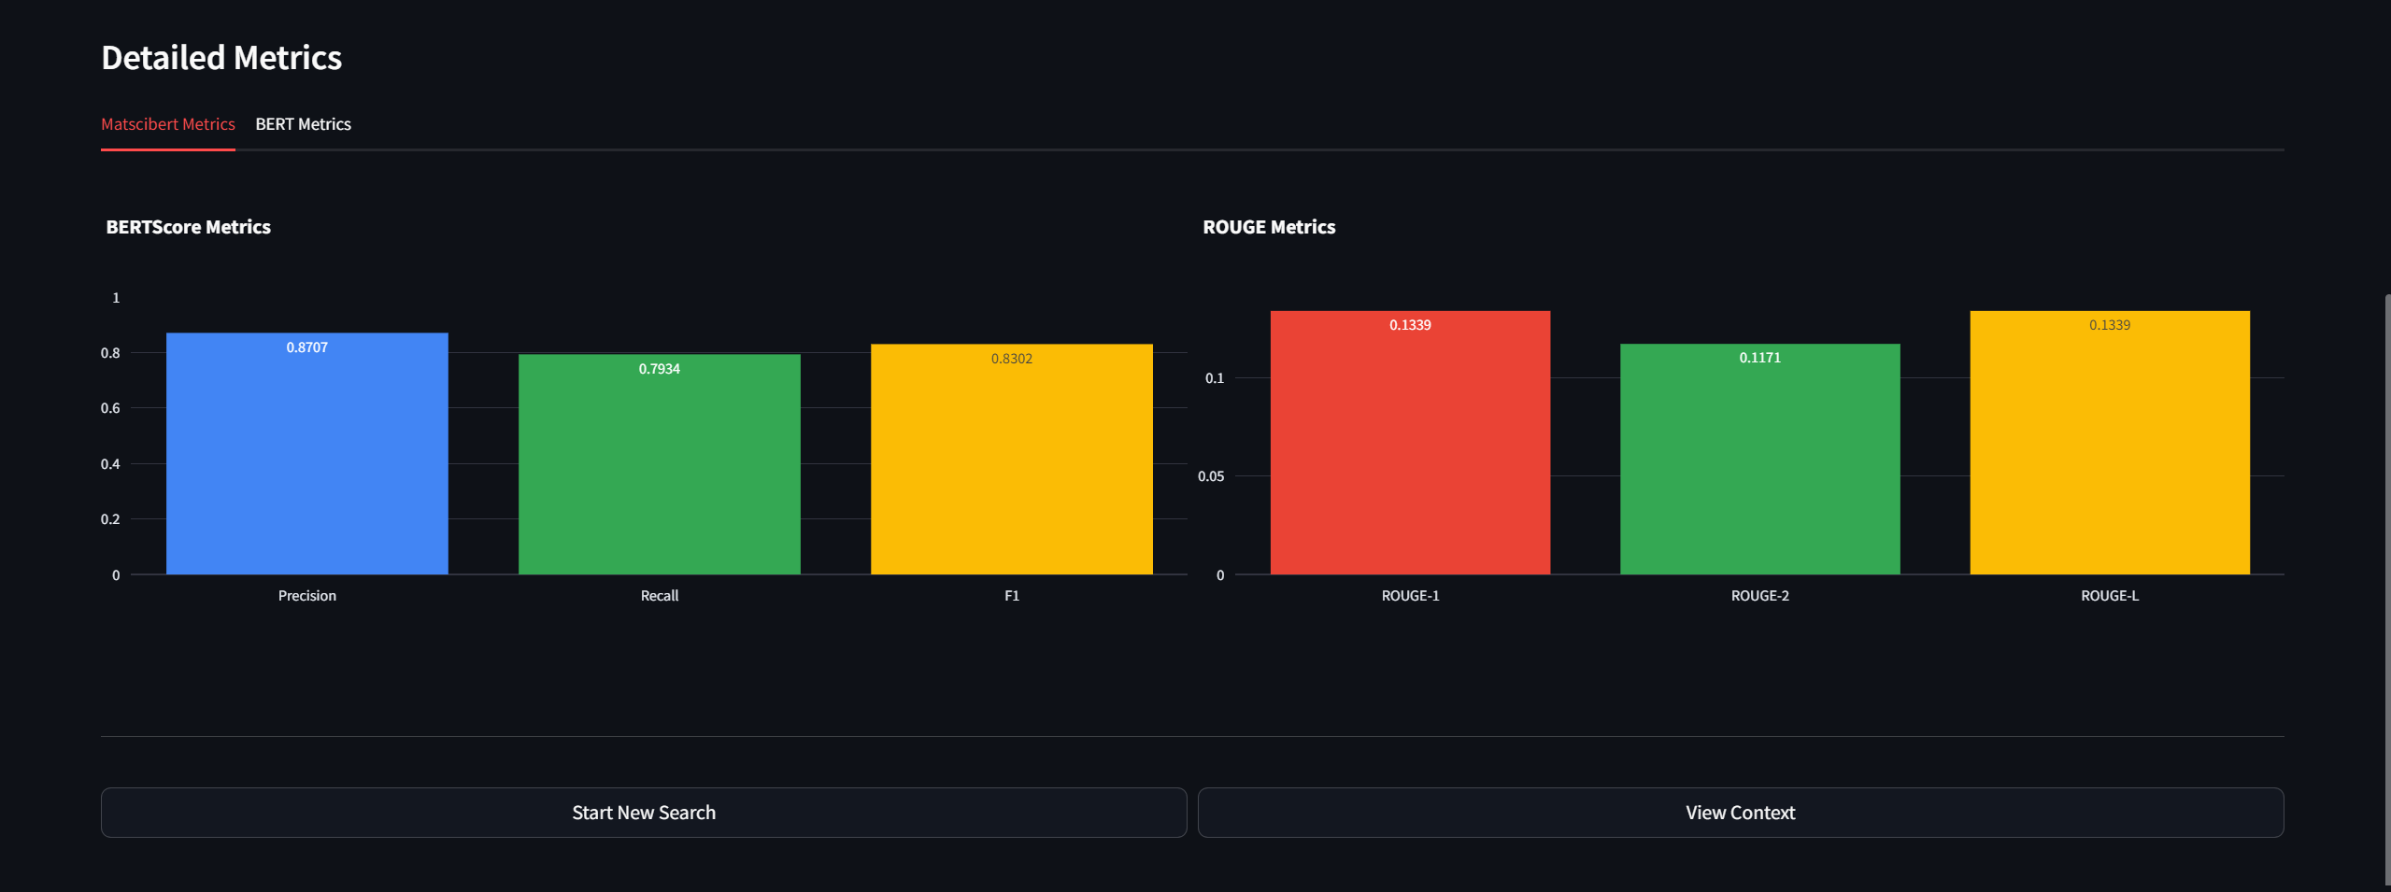
MatSciBert Result

Slide 44
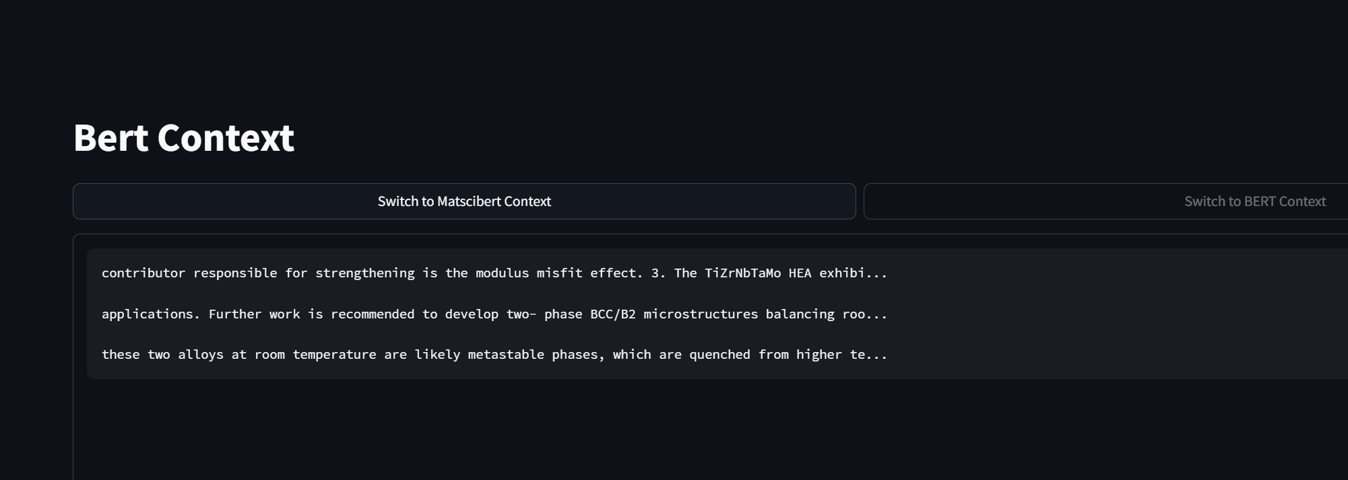
Context of Bert

Slide 45
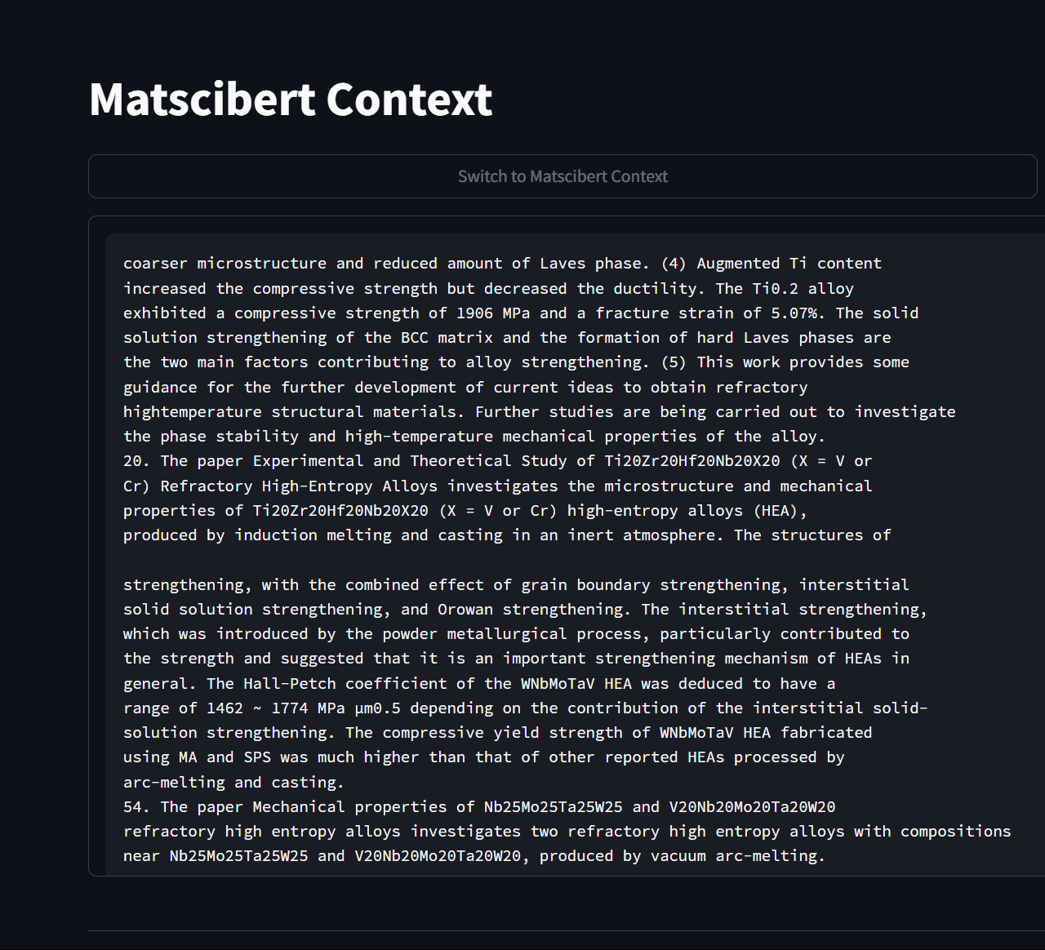
Context of MatSciBert

Slide 46
09 Conclusion & Future Scope
29
Ca
Calcium
3
LI
Lithium
79
Au
Gold

Slide 47
Conclusion
In this work, we built a Retrieval-Augmented Generation (RAG) system that effectively extracts and synthesizes scientific knowledge using MatSciBERT.
By combining advanced retrieval techniques with a powerful LLaMA 3.1 (8B) model, our system generates well-structured, contextually accurate responses to complex scientific queries.
Our results show that MatSciBERT significantly outperforms traditional BERT models, particularly in capturing domain-specific details and preserving factual accuracy.
By fine-tuning key parameters such as system prompts, and retrieval strategies, we optimized response quality and ensured a balance between conciseness and informativeness.
The integration of query expansion and token budget management further refined the relevance of retrieved information, allowing for more precise and meaningful answers.

Slide 48
Future Scope
Future work could focus on improving numerical accuracy, validating citations more explicitly, and expanding the model to handle more complex scientific data formats like tables, graphs, and equations.
These advancements could make AI-driven scientific discovery even more reliable and impactful.
By bridging cutting-edge retrieval methods with powerful language models, our work contributes to the growing field of AI-assisted research helping scientists and researchers access, interpret, and apply knowledge more efficiently.

Slide 49
References
J.-P. Couzini´ e, O.N. Senkov, D.B. Miracle, G. Dirras, Comprehensive data com pilation on the mechanical properties of refractory high-entropy alloys, Materials Science and Engineering A 769 (2019) 138527.
A.Chandrasekhara, J. Chan, F. Ogoke, O. Ajenifujah, A. B. Farimani, AMGPT: a Large Language Model for Contextual Querying in Additive Manufacturing, arXiv preprint arXiv:2406.00031v1 [cs.CL], (2024).
T. Gupta, M. Zaki, N. M. A. Krishnan, Mausam, MatSciBERT: A materials domain language model for text mining and information extraction, npj Computational Materials 8 (2022) 102.
Y. Song, S. Miret, B. Liu, MatSci-NLP: Evaluating Scientific Language Models on Materials Science Language Tasks Using Text-to-Schema Modeling, arXiv:2305.08264v1 [cs.CL] (2023).
M.V.Koroteev, BERT: AReviewofApplications in Natural Language Processing and Understanding, Financial University under the government of the Russian Federation (2023).

Slide 50
Gillioz, J. Casas, E. Mugellini, O. A. Khaled, Overview of the Transformer-based Models for NLP Tasks, Proceedings of the Federated Conference on Computer Science and Information Systems 21 (2020) 179–183.
S. Khan, M. Naseer, M. Hayat, S. W. Zamir, F. S. Khan, M. Shah, Transformers in Vision: A Survey, ACM Computing Surveys (2022) 0360-0300.
T. Wolf, L. Debut, V. Sanh, J. Chaumond, C. Delangue, A. Moi, P. Cistac, T. Rault, R. Louf, M. Funtowicz, J. Davison, S. Shleifer, P. von Platen, C. Ma, Y. Jernite, J. Plu, C. Xu, T. Le Scao, S. Gugger, M. Drame, Q. Lhoest, A. M. Rush, Transformers: State-of-the-Art Natural Language Processing, Proceedings of the 2020 EMNLP (Systems Demonstrations), (2020) 38–45.
H. Li, Y. Su, D. Cai, Y. Wang, L. Liu, A Survey on Retrieval-Augmented Text Generation, arXiv preprint arXiv:2202.01110v2 [cs.CL], (2022).
P. Zhao, H. Zhang, Q. Yu, Z. Wang, Y. Geng, F. Fu, L. Yang, W. Zhang, J. Jiang, B. Cui, Retrieval-Augmented Generation for AI-Generated Content: A Survey, arXiv preprint arXiv:2402.19473v6 [cs.CV], (2024).
M. Sai Rahul, Ashwin Devan, Kurakula Prashanth, M. Srinivasa Sai Kumar Reddy, and Kritesh Kumar Gupta, Design of High Entropy Alloys by using Ma chine Learning driven Bayesian Optimization, 5th International Conference on Current Trends in Materials Science and Engineering, (Presented).

Slide 51
Ashwin Devan- (CB.EN.U4AIE21104) K Prashanth- (CB.EN.U4AIE21126) M Srinivasa Sai Kumar Reddy- (CB.EN.U4AIE21128) M Sai Rahul- (CB.EN.U4AIE21130), Retrieval-Augmented Generation based Knowledge Extraction for Material Science Domain (Ready to be submitted).

Slide 52
Thank You

